Slide 1
Effects of Music on Mental Health

Slide 2
Music and Mental Health - Exploring the Connection
Music is an integral part of daily life for millions of people worldwide, known for its entertainment value and potential therapeutic effects. Recent studies suggest music can significantly impact mental health, influencing emotions, stress levels, and overall psychological well-being.
The primary objective of this project is to explore the causal relationship between music listening habits—such as the duration of listening, preferred genres, and the choice of streaming services—and anxiety levels among individuals. By identifying patterns and potential influences, this research aims to contribute to a better understanding of how music listening might be effectively utilized as a part of mental health management strategies
Using a dataset comprising responses from a diverse group regarding their music-listening behaviors and reported anxiety levels, we employed statistical methods to analyze the data. The analysis began with basic descriptive statistics and correlation analysis, advancing to more sophisticated inferential techniques such as Ordinary Least Squares (OLS) regression to examine potential causal links. Various tests and modifications were applied to address the challenges of multicollinearity and non-normality in the data, ensuring our findings' robustness.
The goal is to establish a robust statistical model to serve as a future research foundation. Initially, we seek to determine if there is a significant association between music listening patterns and anxiety levels, setting the stage for further studies that could delve deeper into causal relationships and explore the effectiveness of tailored music therapy interventions

Slide 3
Literature Review

Slide 4
Data Overview
Source:
The dataset is sourced from a public Kaggle dataset titled "Music and Mental Health Analysis" by user Diksha Aswal. It was collected through a survey to explore the correlation between music listening habits and mental health parameters.
Dataset Characteristics:
Participants: The dataset includes responses from 736 participants, representing a diverse demographic regarding age, gender, and geographical location.
Data Collection Method: Survey responses were collected online, asking participants about their music listening habits and mental health conditions.

Slide 5
Understanding Data
Variables Included
Demographic Information
Music Listening Habits
Mental Health Metrics
Involvement in music
preferences for different music genres
Relevant Features for Analysis
Anxiety – 0 – 10: Primary Dependent variable
Music Listening Duration: hrs per day, Key Independent variable
Music Genre Preferences: Rock, Pop, Classical, etc.,
Streaming Services: Spotify, Apple Music, Pandora, etc.,

Slide 6
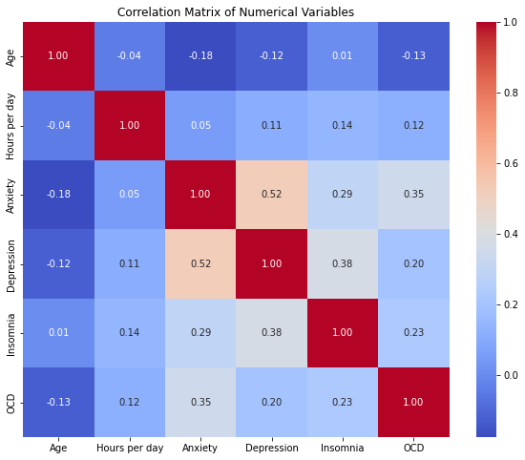
EDA
Anxiety and Depression: A strong positive correlation (r = 0.52) was observed between anxiety and depression levels among participants. This suggests that individuals with higher anxiety levels tend also to experience higher levels of depression.
Depression and Insomnia: A moderate positive correlation (r = 0.38) between depression and insomnia indicates that increases in depression scores are associated with higher levels of insomnia.
Age and Listening Hours: Both age and hours spent listening to music per day showed weak correlations with anxiety, depression, and insomnia, suggesting these factors have less direct impact on mental health metrics within this dataset.

Slide 7
Data Cleaning
The dataset used in this study has 17 missing values from 7 variables, which were removed due to their low percentage (≈2% of the data) and lack of non-random pattern.
However, the variable measuring beats per minute (BPM) has 107 missing values, accounting for approximately 15% of the dataset. To address this, regression imputation was used and two outliers in the BPM data were removed.
Additionally, the response variable "music effect" had an imbalance issue, with only 17 "worsen" responses compared to 534 "improve" and 165 "no effect" responses. To mitigate this effect, the "no effect" and "worsen" levels were merged into one response level called "no improvement".

Slide 8
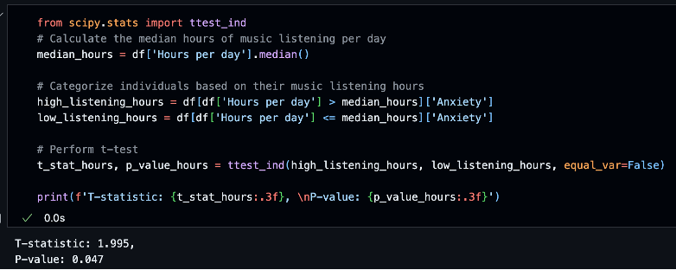
Hypothesis Testing
Null Hypothesis (H0): There is no difference in anxiety levels between individuals who listen to music for more than the median hours per day and those who listen less.
Alternative Hypothesis (H1): Individuals who listen to music for more than the median hours per day have different anxiety levels compared to those who listen less.
The P-value of 0.047 is below the conventional threshold of 0.05, indicating that we can reject the null hypothesis at the 5% significance level. This means that there is a statistically significant difference in anxiety levels between the two groups based on their music listening hours.

Slide 9
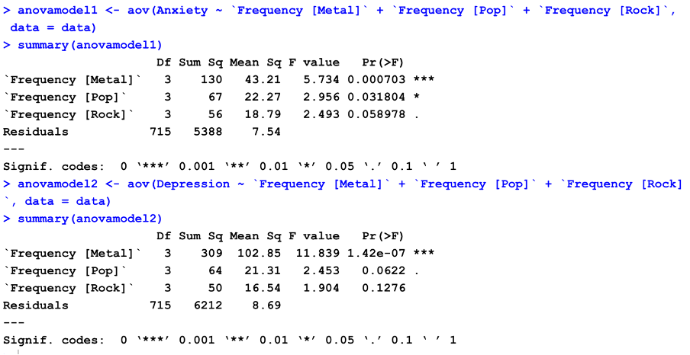
Analysis of Variance
Since we have observed that the top three favorite genres were Rock, Pop and metal. We perform anova test to check whether there are significant differences in Anxiety and Depression for different levels of the variables
Result : The ANOVA results suggest that there are significant differences in anxiety and depression scores across different frequencies of listening to Metal and Pop music. However, for Rock music, while there is some indication of a difference, it is not statistically significant at the conventional alpha level of 0.05.

Slide 10
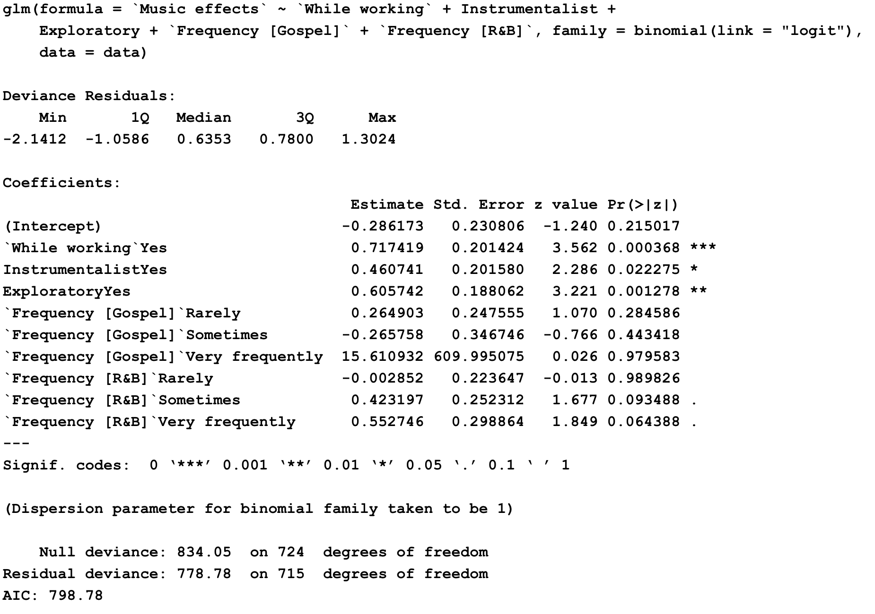
Binary Logit model with Backward selection process
Listening to music while working increases the log odds of improved mental state by approximately 0.72
Being an instrumentalist is associated with better mental health and increases the log odds of improved mental state by approximately 0.46
Exploring different types of music positively impacts mental well-being by increasing the log odds of improved mental state by 0.60.
The coefficients for different frequency levels of listening to gospel and R&B music are not statistically significant at 95% level

Slide 11
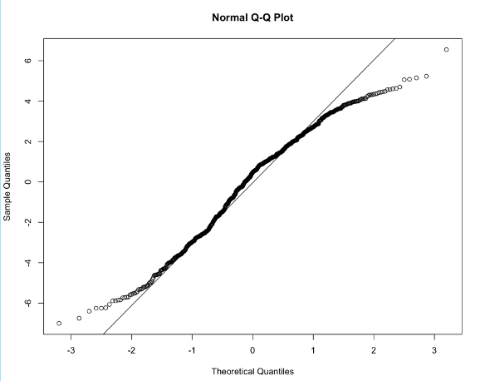
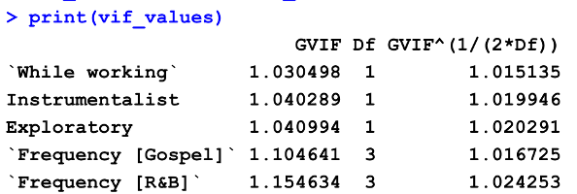
Test for Normality and Multi-Collinearity
The multicollinearity levels, while present, may not be severe enough to cause major issues with the model coefficients.

Slide 12
Conclusion
The study aimed to investigate the effects of music on mental health, specifically focusing on anxiety, depression, insomnia, and OCD. Through a binary logistic regression analysis, the results indicated that certain factors were associated with improved mental state:
Listening to music while working increased the likelihood of experiencing an improved mental state.
Exposure to music performed by instrumentalists was linked to better mental well-being.
Exploring different types of music had a positive impact on mental health.
Additionally, the ANOVA tests revealed significant differences in anxiety and depression scores across different frequencies of listening to metal and pop music. Individuals who listened to these genres more frequently reported higher levels of anxiety and depression.
The hypothesis testing further supported the finding that individuals who listened to music for more than the median hours per day had higher anxiety levels compared to those who listened less.
Overall, the study highlights the potential benefits of music on mental health, particularly when incorporated into daily activities and when exploring diverse musical genres.

Slide 13
Future Scope
Conduct longitudinal studies: To establish a stronger causal relationship between music and mental health, future research could employ longitudinal study designs that track individuals' mental health over time while monitoring their music listening habits.
Investigate the role of music therapy: Building upon the findings of this study, future research could explore the potential of music therapy as a complementary treatment approach for individuals with mental health conditions, such as anxiety and depression.
Examine the effects of music on other mental health conditions: The current study focused on anxiety, depression, insomnia, and OCD. Future research could expand the scope to investigate the impact of music on other mental health conditions, such as stress, trauma, or mood disorders.
Incorporate physiological and neurological measures: To gain a more comprehensive understanding of the mechanisms through which music influences mental health, future studies could incorporate physiological and neurological measures, such as brain activity, heart rate variability, and hormonal responses.

